Slide 1





What’s the Internet: “nuts and bolts” view
Internet: “network of networks”
  loosely hierarchical: company networks, access networks, local ISPs (Internet Service Providers), regional ISPs
  millions of connected computing devices: hosts, end-systems
  pc’s workstations, servers
  PDA’s phones, toasters
  running network applications
communication links made up of different physical media:
  fiber, copper, radio, satellite
routers: forward packets (chunks) of data thru network
router
workstation
server
mobile
local ISP
To backbone
provider
Access Network
regional ISP
company
network

Slide 2
1.1 What’s the Internet: “nuts and bolts” view
protocols control the sending and receiving of information (messages) within the Internet
  e.g., TCP, IP, HTTP, FTP, PPP
Internet standards
  IETF, the Internet Engineering Task Force, is where many of the “standards” used in the Internet today were discussed and created. IETF is a forum that is open to any interested individuals. The standards it created are contained in documents known as RFCs, or Request for comments.
  Important websites:
    Internet Engineering Task Force (IETF) – www.ietf.org
    Internet Society – www.isoc.org
    The World Wide Web Consortium (W3C) – www.w3.org/Consortium
    and others listed in section 1.1.3 of the text.

Slide 3
What’s the Internet: a service view
communication infrastructure enables distributed applications:
  WWW, email, games, e-commerce, database, voting,
  more?
communication services provided:
  Connectionless
    Vs.
  Connection-oriented
  The dichotomy of connectionless/connection-oriented service can be applied to different communication layers. We will return later to the concept of layering.

Slide 4
Chapter 1: Computer Networks and the Internet
1.1 what’s the Internet?
1.2 what’s a protocol?
1.3 network edge – end devices
1.4 network core – circuit, packet, and message switching
1.5 access networks & physical media
1.6 performance: loss, delay
1.7 protocol layers & service models
1.8 Internet backbones, NAPs, ISPs
1.9 history

Slide 5
1.2 What’s a protocol?
protocols define format, order of messages sent and received among network entities, and actions taken on msg transmission, receipt
… specific msgs (messages) sent
… specific actions taken when msgs received, or other events
network protocols:
machines rather than humans
all communication activity in Internet governed by protocols
An important concept is that Communication protocols are structured in layers. Each protocol layer makes uses of the services provided by the layer below and provides a service to the layer above.

Slide 6


What’s a protocol?
a human protocol and a computer network protocol:
Hi
TCP connection
req.
Hi
TCP connection
reply.
Got the
time?
Get http://gaia.cs.umass.edu/index.htm
2:00
<file>
time

Slide 7
A closer look at network structure:
network edge: applications and hosts
network core:
  routers
  network of networks
access networks, physical media: communication links

Slide 8
1.3 The network edge:
end systems (hosts):
  run application programs
  e.g., WWW, email
  at “edge of network”
client/server model
  client initiates requests to and receives service from server
  e.g., WWW client (browser)/ server; email client/server
peer-peer model:
  host interaction is symmetric
  e.g.: teleconferencing

Slide 9
Network edge: connection-oriented service
Goal: data transfer between end sys.
handshaking: setup (prepare for) data transfer ahead of time
  Hello, hello back human protocol
  set up “state” in two communicating hosts
TCP - Transmission Control Protocol
  Internet’s connection-oriented service
TCP service [RFC 793]
reliable, in-order byte-stream data transfer
  loss: acknowledgements and retransmissions
flow control:
  sender won’t overwhelm receiver
congestion control:
  senders “slow down sending rate” when network congested

Slide 10
Network edge: connectionless service
Goal: data transfer between end systems
  same as before!
UDP - User Datagram Protocol [RFC 768]: Internet’s connectionless service
  unreliable data transfer
  no flow control
  no congestion control
  but faster!
App’s using TCP:
HTTP (WWW), FTP (file transfer), Telnet (remote login), SMTP (email)
App’s using UDP:
streaming media, teleconferencing, Internet telephony

Slide 11
1.4 Network Core
Circuit Switching vs. Packet Switching
The fundamental question: how is data transferred through net?
  Circuit switching: dedicated circuit per call: telephone net
  Packet switching: data sent thru net in discrete “chunks”
  In circuit switching, a channel of fixed rate (bandwidth) is provided between the communicating end-points. In packet switching, packets are exchanged only as needed.
  In circuit switching, identity of the data being transferred is provided implicitly by its time slot or frequency assignment. In packet switching, identity of data must be explicitly specified by a header.
  Circuit switching must be connection-oriented. Packet switching can be connectionless (datagram), or connection-oriented (virtual circuit).
Modern computer communication is based on packet switching

Slide 12
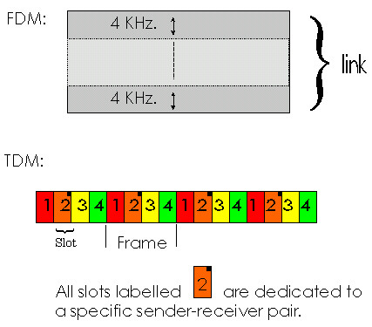
Network Core - Circuit Switching
Circuit Switching
call setup (and tear-down) required
split bandwidth into “pieces” by
  frequency division or
  time division
Bandwidth and switch resources reserved for the duration of a call
dedicated resources: no sharing
circuit-like (guaranteed) performance
Ex: telephone network

Slide 13
Network Core: Packet Switching
each end-end data stream divided into packets
user A, B packets share network resources
each packet transmitted at full link bandwidth
resources used as needed,
resource contention:
aggregate resource demand can exceed amount available
congestion: packets queue, wait for link use
store and forward: packets move one hop at a time
  transmit over link
  wait turn at next link
Bandwidth division into “pieces”
Dedicated allocation
Resource reservation

Slide 14
Circuit Switching | Message Switching | Packet Switching
Dedicated Path | No dedicated path | Message is divided into small chunks called packets
Connection oriented | Each message is treated as independent unit. Includes source and destination address. | Individual packets take different paths to reach the destination.
No Delay in data flow | Uses store and forward, Some delay due to store & forward. | Delay is less
More BW is required | Large storage Capacity is required. | Required BW is reduced.
Communications establish time is more. Link can’t be used to send any other data even when free. | - | In link failure different routes can be choosen.
Ex:Telephone | Ex:Telegraph | Internet

Slide 15
Network Core: Packet Switching
10 Mbs
Ethernet
A
C
statistical multiplexing
1.5 Mbs
B
queue of packets
waiting for output
link
45 Mbs
D
E
Packet-switching versus circuit switching: human restaurant analogy

Slide 16
Packet switching versus circuit switching
Packet switching allows more users to use network!
1 Mbit link
each user:
  100Kbps when “active”
  active 10% of time
circuit-switching:
  10 users
packet switching:
  with 35 users, the probability that more than 10 users are active in a given time is less than .004. When it happens, excess packets are queued up and suffer additional delays.
N users
1 Mbps link

Slide 17
Packet switching versus circuit switching
Is packet switching a “slam dunk winner?”
Great for bursty data
  resource sharing
  no call setup
Excessive congestion: packet delay and loss
  protocols needed for reliable data transfer, congestion control
Q: How to provide circuit-like behavior?
  bandwidth guarantees needed for audio/video apps
  still an unsolved problem (chapter 6)

Slide 18
Packet-switching: store-and-forward
L
R
R
R
Takes L/R seconds to transmit (push out) packet of L bits on to link with rate R bps
Entire packet must arrive at router before it can be transmitted on next link: store and forward
delay = 3L/R
Example:
L = 7.5 Mbits
R = 1.5 Mbps
delay = 15 sec

Slide 19
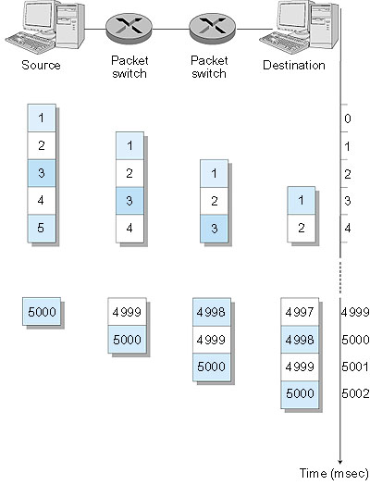
Packet Switching: Message Segmenting
Now break up the message into 5000 packets
Each packet 1,500 bits
1 msec to transmit packet on one link
pipelining: each link works in parallel
Delay reduced from 15 sec to 5.002 sec

Slide 20
Packet-switched networks: routing
Goal: move packets among routers from source to destination
datagram network:
  destination address determines next hop
  routes may change during session
  analogy: driving, asking directions
virtual circuit network:
  each packet carries tag (virtual circuit ID), tag determines next hop
  fixed path determined at call setup time, remains fixed thru call
  routers maintain per-call state

Slide 21
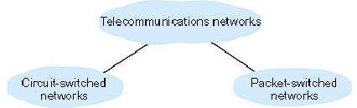

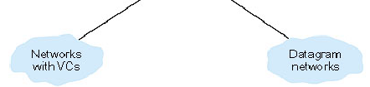
Core Network - Summary

Slide 22
1.5 Access networks and physical media
Q: How to connect end systems to edge router?
residential access nets
institutional access networks (school, company)
mobile access networks
Keep in mind:
bandwidth (bits per second) of access network?
shared or dedicated?

Slide 23
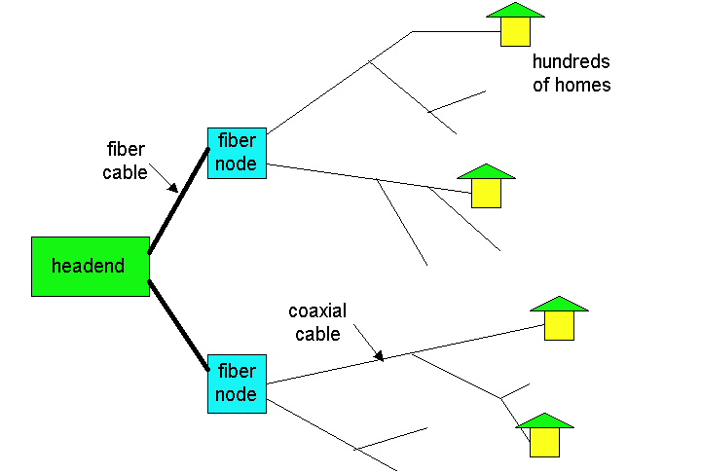
Residential access
Cable Modem
HFC: hybrid fiber coax
  asymmetric: up to 10Mbps upstream, 1 Mbps downstream
network of cable and fiber attaches homes to ISP router
  shared access to router among homes
  issues: congestion, dimensioning
deployment: available via cable companies
Point-to-point
Dialup via modem
  up to 56Kbps direct access to router (conceptually)
ISDN: integrated services digital network: 128Kbps all-digital connect to router
ADSL: asymmetric digital subscriber line
  up to 1 Mbps home-to-router
  up to 8 Mbps router-to-home

Slide 24
Institutional access: local area networks
company/univ local area network (LAN) connects end system to edge router
Ethernet:
  shared or dedicated cable connects end system and router
  10 Mbs, 100Mbps, Gigabit Ethernet
deployment: institutions, home LANs soon
LANs:

Slide 25
Wireless access networks
shared wireless access network connects end system to router
wireless LANs:
  radio spectrum replaces wire
  e.g., Lucent Wavelan 10 Mbps
wider-area wireless access
  CDPD: wireless access to ISP router via cellular network
router
base
station
mobile
hosts

Slide 26
Physical Media
Twisted Pair (TP)
two insulated copper wires
  Category 3: traditional phone wires, 10 Mbps Ethernet
  Category 5 TP: 100Mbps Ethernet
physical link: transmitted data bit propagates across link
guided media:
  signals propagate in solid media: copper, fiber
unguided media:
  signals propagate freely, e.g., radio

Slide 27


Physical Media: coax, fiber
Coaxial cable:
wire (signal carrier) within a concentric shield
  Baseband (50 ohm): single channel on cable. ~1cm thick, popular in old 10 Mbs Ethernet
  Broadband (75 ohm): multiple channels on cable, each channel shifted to a different frequency band. Thick and stiffer, common in cable TV systems.
bidirectional
Fiber optic cable:
glass fiber carrying light pulses
high-speed operation:
  100Mbps Ethernet
  high-speed point-to-point transmission (e.g., 10 Gps)
low error rate

Slide 28
Physical media: radio
signal carried in electromagnetic spectrum
no physical “wire”
bidirectional
propagation environment effects:
  reflection
  obstruction by objects
  interference
Radio link types:
microwave
  e.g. up to 45 Mbps channels
LAN (e.g., waveLAN)
  2Mbps, 11Mbps
wide-area (e.g., cellular)
  e.g. CDPD, 10’s Kbps
satellite
  up to 50Mbps channel (or multiple smaller channels)
  270 Msec end-end delay
  geosynchronous versus LEOS

Slide 29
1.6 Delay & Loss in packet-switched networks
packets queue in router buffers
packet arrival rate to link exceeds output link capacity
packets queue, wait for turn
packet being transmitted (delay)
A
B
packets queuing (delay)
free (available) buffers: arriving packets
dropped (loss) if no free buffers

Slide 30
Delay in packet-switched networks
packets experience delay on end-to-end path
four sources of delay at each hop
1. nodal processing:
  check bit errors
  determine output link
2. queuing:
  time waiting at output link for transmission
  depends on congestion level of router
transmission
A
propagation
B
nodal
processing
queuing

Slide 31
Delay in packet-switched networks
3. transmission delay:
R=link bandwidth (bps)
L=packet length (bits)
time to send bits into link = L/R
4. propagation delay:
d = length of physical link
s = propagation speed in medium (~2x10⁸ m/sec)
propagation delay = d/s
Note: s and R are very different quantities!
transmission
A
propagation
B
nodal
processing
queuing

Slide 32

Queuing delay (revisited)
R=link bandwidth (bps)
L=packet length (bits)
a=average packet arrival rate
traffic intensity = La/R
La/R ~ 0: average queuing delay small
La/R -> 1: delays become large
La/R > 1: more “work” arriving than can be serviced, average delay infinite!

Slide 33
“Real” Internet delays and routes
What do “real” Internet delay & loss look like?
Traceroute program: provides delay measurement from source to router along end-end Internet path towards destination. For all i:
  sends three packets that will reach router i on path towards destination
  router i will return packets to sender
  sender times interval between transmission and reply.
3 probes
3 probes
3 probes

Slide 34
Packet loss
queue (aka buffer) preceding link in buffer has finite capacity
when packet arrives to full queue, packet is dropped (aka lost)
lost packet may be retransmitted by previous node, by source end system, or not retransmitted at all

Slide 35
1.7 - Protocol “Layers”
Networks are complex!
many “pieces”:
  hosts
  routers
  links of various media
  applications
  protocols
  hardware, software
Question:
Is there any hope of organizing structure of network?
Or at least our discussion of networks?
Layering breaks a complex problem into smaller pieces with clear relationships
explicit structure allows identification, relationship of complex system’s pieces
  Provide a reference model for discussion
modularization eases maintenance, updating of system
  Allow changes in implementation of a layer without affecting the rest of the system

Slide 36
Protocol Layering and Data
Each protocol layer:
Contains “entities” implementing layer functions at each node, which may include: Error Control, Flow Control, Segmentation and Reassembly, Multiplexing, and Connection Setups.
entities perform actions and exchange messages known as Protocol Data Units (PDU) with peers. Layer n entities would exchange n-PDU using the service of layer n-1.
Each layer takes data from above
  adds layer header information to create new data unit
  passes new data unit to layer below
source
destination
M
Layer 5
Layer 4
Layer 3
Layer 2
Layer 1
Layer 5
Layer 4
Layer 3
Layer 2
Layer 1
M
5-PDU
H
4
M
H
4
M
4-PDU
H
H
H
H
M
3-PDU
3
4
M
3
4
H
H
H
H
H
H
M
2-PDU
2
3
4
M
2
3
4

Slide 37
Internet protocol stack
application: supporting network applications
  ftp, smtp, http
transport: host-host data transfer
  tcp, udp
network: routing of datagrams from source to destination
  ip, routing protocols
link: data transfer between neighboring network elements
  ppp, ethernet
physical: bits “on the wire”, modulation scheme, line-coding format, electrical & physical specifications, etc.
Routers in the network operate only up to the Network Layer
application
transport
network
link
physical
Host
Router

Slide 38
Example of Layering: logical communication
E.g.: transport
take data from app
add addressing, reliability check info to form “datagram”
send datagram to peer using service provided by the Network Layer
wait for peer to acknowledge receipt
data
application
transport
network
link
physical
transport
ack
network
link
physical
application
transport
network
link
physical
data
data
application
transport
network
link
physical
application
transport
network
link
physical
transport

Slide 39
Layering: physical communication
data
application
transport
network
link
physical
network
link
physical
application
transport
network
link
physical
data
application
transport
network
link
physical
application
transport
network
link
physical

Slide 40
1.8 Internet structure: network of networks
roughly hierarchical
national/international backbone providers (NBPs)
  e.g. BBN/GTE, Sprint, AT&T, IBM, UUNet
  interconnect (peer) with each other privately, or at public Network Access Point (NAPs)
regional ISPs
  connect into NBPs
local ISP, company
  connect into regional ISPs
local
ISP
regional ISP
NBP B
NAP
NAP
NBP A
regional ISP
local
ISP

Slide 41
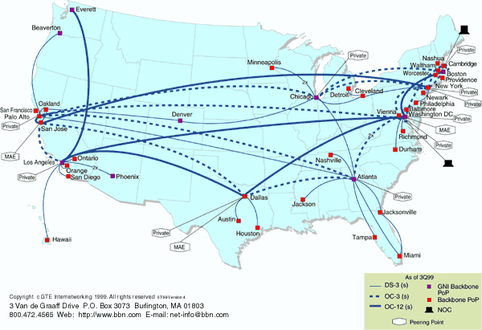
National Backbone Provider
e.g. BBN/GTE US backbone network

